Slide 1
Default and Recovery Implicit in the Term Structure of Sovereign CDS Spreads
Jun Pan and Kenneth J. Singleton
- Hariharan Pk

Slide 2
Contents
Introduction
Structure of Sovereign CDS Contracts
Sample Data
Pricing CDS Contracts
Interpreting & Separately Identifying λQ and LQ
Maximum Likelihood Estimates
Monte Carlo Analysis
Model Pricing Error
Risk Premium & Dependence on US Economy
Regression Results
Conclusion
Opinion

Slide 3
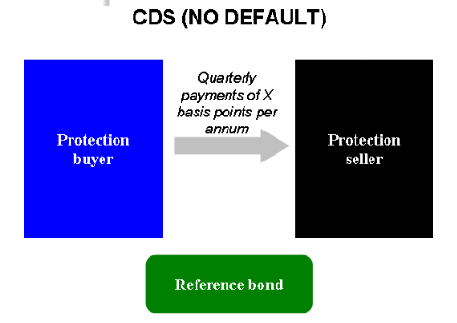
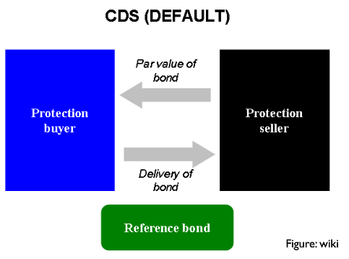
Introduction
A credit default swap is a designed to transfer the credit exposure of fixed income products between two or more parties. In a credit default swap, the buyer of the swap makes payments to the swap’s seller up until the maturity date of a contract. In return, the seller agrees that, in the event that the debt issuer defaults or experiences another credit event, the seller will pay the buyer the security’s premium as well as all interest payments that would have been paid between that time and the security’s maturity date.

Slide 4
Structure of Sovereign CDS Market

Slide 5
Structure of Sovereign CDS Market
Central to our analysis of the term structure of sovereign CDS spreads is the active trading of contracts across a wide range of maturities.
In contrast to the U.S. corporate and bank CDS markets, where a large majority of the trading volume is concentrated in ﬁve-year contracts, the three- and ten-year contracts have each accounted for roughly 20% of the volumes in sovereign markets, and the one-year contract has accounted for an additional 10% of the trading.
The total volume of new contracts has been much larger in the corporate than in the sovereign market, the volumes for the most actively traded sovereign credits are large and growing.

Slide 6
Credit Events
Obligation Acceleration
Failure to Pay
Restructuring
Repudiation/Moratorium

Slide 7
Sample Data
Sample Period of the paper – March 19,2001 through August 10, 2006
Analysis is focused on Mexico, Turkey, and Korea
Geographically dispersed - Latin America, Eastern Europe and Asia
Broad range of credit quality – Rating of three countries throughout the sample period
Regional Representativeness
Relative Liquidity

Slide 8
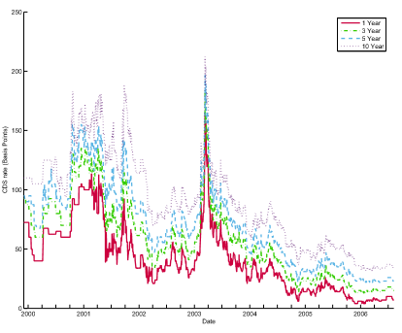
CDS Spreads
Mexico
Korea
Turkey

Slide 9
CDS Spreads
Co-Movement
Co-movement of 1, 3, 5 and 10 year CDS
Principal Component Analysis
First PC explains 96% of the variation for all three countries except 1-yr Mexico CDS (90%)
Motivation for using one factor model
Persistent Upward Sloping Trend
Why is the spread negative for Turkey ?

Slide 10
Pricing Sovereign CDS Contracts
CDSt(M) = The spread on a CDS contract with maturity M
RQ = The(constant) fractional recovery of face value on the underlying bond in the event of default
LQ = (1−RQ)
λQ = The risk neutral intensity of default.

Slide 11
Interpreting λQ and LQ
Four types of Credit events – acc, fail, rest, repud
Each of these credit events has its own associated arrival intensity λQ and loss rate LQ
Upon the occurrence of a credit event of type i, the relevant loss rate is LQ and, given that a credit event has occurred, this loss rate is experienced with probability λQit/λQt

Slide 12
Identifying LQ
1) Recoveries estimated by agencies - For example, Moody’s (2003) estimates of the recoveries on several recent sovereign defaults are:
Argentina 28%; Ecuador 45%; Moldova 65%; Pakistan 48%; and Ukraine 69%. However setting the LQ based on historical experience requires the assumption that that there is no risk premium on recovery, LQ = LP
2) Set LQ = 0.75 and bootstrap λQ or use a one factor parametric model for the λQ process to match the day’s cross section of spread

Slide 13
Now The Question…
Can λQ and LQ be separately identified from a time series of market provided spreads on newly issued CDS Contracts ?

Slide 14
Separately Identifying λQ and LQ – RMV Framework
A common impression among practitioners is that ﬁxing LQ at a speciﬁc value is necessary to achieve econometric identiﬁcation. This is certainly true in an economic environment in which contracts are priced under the fractional recovery of market value convention (RMV)
In such a pricing framework, the product λQ × LQ determines prices in the sense that the time-t spread on a defaultable bond takes the form
CDSRMV = g(λQ * LQ)
for some function g. That λQ and LQ enter symmetrically implies that they cannot be separately identiﬁed using defaultable bond data alone

Slide 15
Separately Identifying λQ and LQ – RFV Framework
In the pricing framework of fractional recovery of face value (RFV), which is the most natural pricing convention for CDS contracts, λQ and LQ play distinct roles.
Speciﬁcally, the CDS pricing relation takes the form –
CDSt = LQ * f(λQ)
Here we can see that the joint identiﬁcation problem in the RMV framework is no longer present for CDS prices

Slide 16
Maximum Likelihood Estimates
For unconstrained case, LQ is very low for Mexico and Turkey, but LQ of Korea is close to market convention

Slide 17
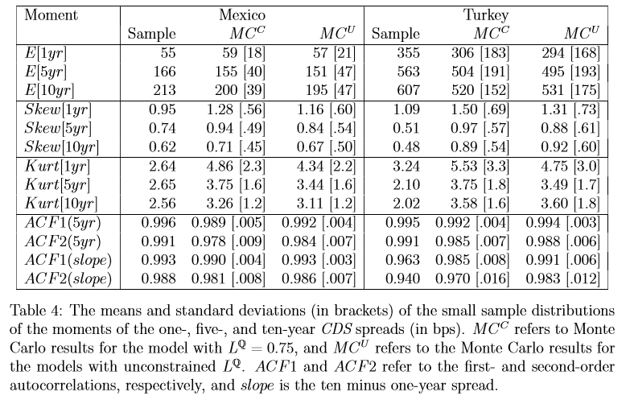
Distribution of Mexico & Turkey CDS Spreads – Monte Carlo Analysis
Features of the implied distributions of CDS spreads for Mexico and Turkey are similar across the cases of LQ equal to 0.75 or 0.25.

Slide 18
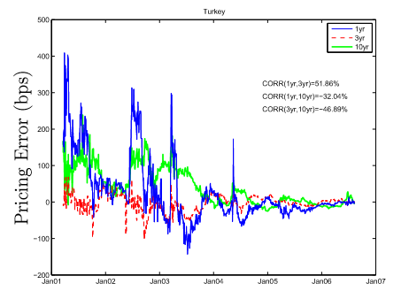
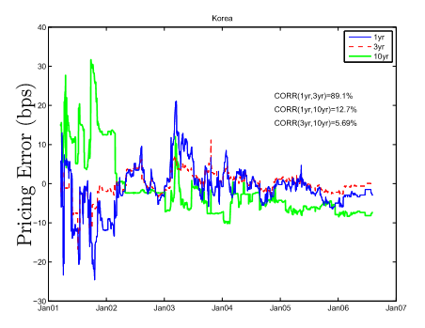
Model Pricing Error

Slide 19
Pricing Error
The one-factor model misprices the one-year contract most severely.
These observations suggest that there are components of the short ends of the CDS curves that are not well captured by our one-factor models.
One-year pricing error on the second PC of the CDS spreads, gives R2′s of 67.6% for Mexico, 45.9% for Turkey, and 65.1% for Korea.
The corresponding R2 for the pricing errors on longer maturity contracts decline substantially with maturity in the cases of Mexico and Turkey, suggesting that what PC2 is picking up is primarily a short-maturity phenomenon in these markets.

Slide 20
One Factor Enough?
A single factor model with λQ following a lognormal distribution captures the most variation of the term structure of CDS Spreads

Slide 21
Priced Risk in Sovereign CDS Market
There is a systematic risk related to changes in future arrival rates of sovereign credit events that is priced in the CDS market.
If market participants are neutral towards the risk of variation over time in λQ, then CDS p t (M) should replicate the corresponding market price CDS t (M).
A mark-up in the CDS spread relative to the pseudo-spread implies that the buyer of the CDS contract is willing to pay a premium for holding the CDS contract, while the seller demands a premium.

Slide 22
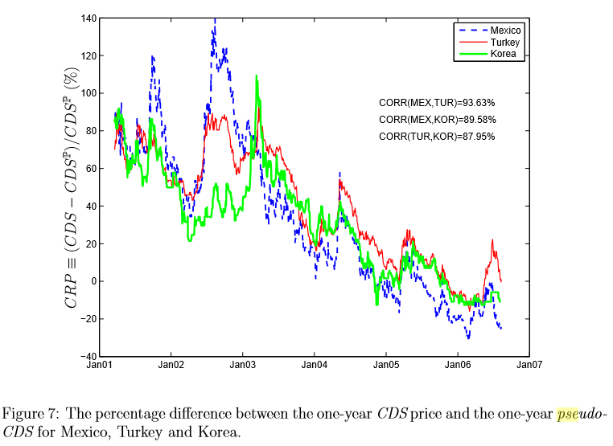
Risk Premium

Slide 23
Dependence On US Economy
The strengths of the economies in all three of the countries examined depend, to varying degrees and through various economic channels, on the strength of the U.S. economy.
The sample correlations of ISM and the growth rates for Korea, Turkey, and Mexico are 0.66, 0.65, and 0.58.
For Korea, gap between the measures of economic growth occurred during 2004 when Korea experienced a marked slowdown in private consumption expenditures as a consequence of the consumer debt overhang

Slide 24
CRP & US-Spread Correlation
VIX is a key factor in investors’ appetite for global “event risk” in credit markets

Slide 25
OLS Regression
To examine the relative contributions of the risk factors VIX, US-Spread, and the own-country implied currency option volatility (CVOL) to the variation in the individual country CRP’s
Risk factor CVOL is included to assist in capturing the eﬀects of capital ﬂows
In the multivariate regressions for Mexico and Turkey both VIX and US-Spread have signiﬁcant explanatory power.
In the case of Korea, US-Spread and CVOL contribute explanatory power, while VIX is statistically insigniﬁcant.

Slide 26
OLS Regression Results

Slide 27
Conclusion
A single factor model with λQ following a lognormal distribution captures the most variation of the term structure of CDS Spreads
Discussed about the systematic, priced risks associated with unpredictable future variation in the credit-event arrival intensity λQ for three countries: Mexico, Turkey, and Korea
The eﬀects of these risk premiums on CDS spreads co-vary strongly across countries, and large moves in these premiums have natural interpretations in terms of political, macroeconomic, and ﬁnancial market developments during the sample period.
Premiums on Sovereign CDS –
Real Economic growth of US – CDS Premiums is influenced by spillovers of real economic growth in the US to other countries
Change in investor’s appetites for credit exposure at a global level outweighs the reassessments of the fundamental strengths of the specific sovereign economies
Using both analytic calculations of the scores of the likelihood functions and Monte Carlo analysis of small-sample distributions, the parameters governing the arrival rate of credit events (λQ) and the loss given an event (LQ) are separately identiﬁable using time-series data on the term structure of CDS spreads.

Slide 28
My Opinion
Only in the case of Korea, the unconstrained maximum likelihood estimates of LQ for the full sample period were in the region of the market convention, LQ = 0.75.
This leaves the question of whether or not there are features of the distribution of CDS spreads for countries like Mexico or Turkey that the lognormal models are not capturing
Simply because LQ = 0.75 is market convention, it is not a good reason to accept it as the best description of history. Market makers typically set LQ by matching the cross-maturity prices of CDS contracts on a given day.
Therefore, the question of what is the best setting of LQ for matching the time-series properties of CDS spreads should first be answered before using it

Slide 29
Thank You!

